Slide 1
Non- Linear Regression
Data 624 – Predictive Analytics
Gabriel Santos
Anjal Hussan
April 18 - 2023
Notes:
Linear regression is not always the best model for our data, not all data follows a straight line.
Overfitting.
Dimension returns

Slide 2
Regression
A regression is a statistical technique that relates a dependent variable to one or more independent (explanatory) variables. A regression model is able to show whether changes observed in the dependent variable are associated with changes in one or more of the explanatory variables.
Linear and Multiple Regressions are commonly used types of Regression Analysis.
Regression is commonly used in research and data analysis to model and predict relationships between variables.
Notes:
The regression can be linear or nonlinear, depending on whether the relationship between the variables can be approximated by a linear function or not.

Slide 3
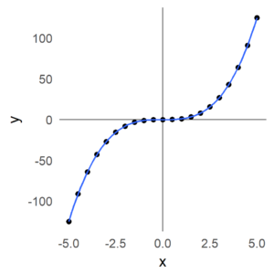
What is Non linear regression?
In nonlinear regression, a nonlinear function is used to model the relationship between the dependent variable and the independent variable(s).
This function can be any mathematical function, such as an exponential, logarithmic, polynomial, trigonometric function, etc.
Notes:
Nonlinear regression is a more complex technique than linear regression, since no closed analytical solution can be found, and therefore the use of numerical methods is required to find the parameters of the nonlinear function that best fit the data.

Slide 4
Linear regression vs. Non-linear regression
In linear regression, the relationship between the dependent variable and the independent variable is modeled by a linear function, such as a line.
Equation for linear regression: y = ax + b + ε
● a = slope ● b=constant ● ε = noise
In nonlinear regression, the relationship between the dependent variable and the independent variable is modeled by a nonlinear function, such as a curve.
Equation for nonlinear regression: y = f(x,β) + ε, where:
● x = a vector of p predictors
● β = a vector of k parameters
● f = a known regression function
● ε = an error term
Notes:
In linear regression: The goal of linear regression is to find the line that best fits the data.
In nonlinear regression: The goal of nonlinear regression is to find the nonlinear function that best fits the data.
This will allow the model to capture the curvature in the scatterplot.
Quadratic model are flexible, since higher order models such x³ can be inserted in the model.
Adding terms may lead to overfitting.

Slide 5
Non-Linear Regression Pros and Cons
Advantages:
They can fit almost any functional form and you don’t need to know the form before training the model
Can model much more complex relationships between the predictors and the outcome than linear models
Disadvantages:
Often not very interpretable
Can be computationally expensive
Some models can be prone to overfitting
Notes:
Data Set
We can see that the first sales person worked at BUcars for 168 weeks and sold a total of 272 cars, So more than a car fer week which is pretty good.
The second person worked for 428 but only sold 300 cars, so less than 1 per week. And so on and so forth.
So as always the first thing we do is graph our data.
Lets test thing out
y = 114.5 + 0.58 *
R-squared: 0.8019
For each week a person is at BUcars’s is expected to sell about than a half os a car perweek(0.58). expected increase of 0.58 per week.

Slide 6
Example in R
https://rpubs.com/GabrielSantos/1029918
Notes:
Let's see a small example of linear and nonlinear regression
Goal: we want to produce a model that minimizes error
Good for new data.
First we are going to produce a model that fits the data well but not to well for predicting data

Slide 7
Example in R
Notes:
Let's see a small example in Study of linear and nonlinear regression
R Square explains the % of the variance in the independent variable.
Mean square of residual 2.110
F statistics = 52.63 – very high and significance = 6.41E-06 is very small.
The linear model is statistically significant

Slide 8
The Non-linear Model
Based off the original scatterplot and even more so the residual plot, it appears that a linear model is not the best choice to model the data
Too much reducible error.
The residual plot shows a definitive curvature.
This indicates that the best model may be non-linear.
Polynomial regression adds extra independent variables that are powers of the original variable: x, x², x³ etc.
Notes:
Adding terms can lead to overfitting

Slide 9
Non-linear Regression Models
There are numerous regression models that are inherently nonlinear in nature, we will focus on following four models:
1. Neural Networks
2. Support Vector Machines (SVMs)
3. Multivariate Adaptive Regression Splines (MARS)
4. K-Nearest Neighbors (KNNs)

Slide 10
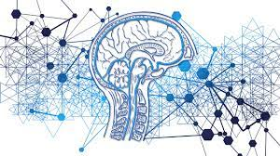
Neural Networks
Neurons: Basic unit of neural network also known as node
Layers: A group of neurons. There is one input layer, one output layer, and one or more hidden layers.
Activation Function: Used to introduce non-linearity to model.
Learning Rate: The amount by which weights are changed and is used during backpropagation.
Gradient Descent: It is an optimization algorithm used for finding weights of ML algorithm.
Backpropagation: Training method for feedforward neural networks used by neurons to adapt their weight to acquire new knowledge
Notes:
Neural networks are powerful nonlinear regression techniques inspired by theories about how the brain works. They allow for complex non-linear relationships between the response variable and its predictors.

Slide 11
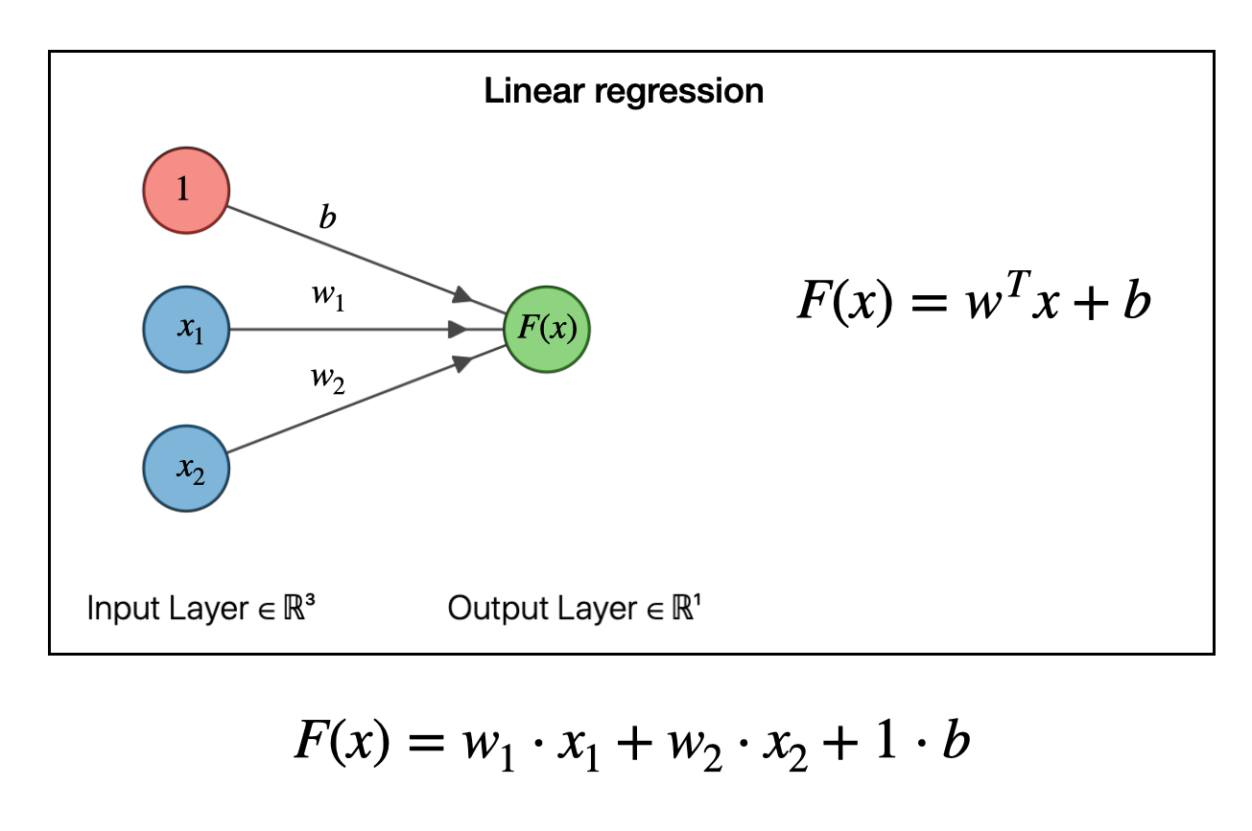
Neural Networks
The simplest neural network contains no
hidden layer and are equivalent to linear regression.
Three inputs in the figure are the
predictors and coefficients attached to
these predictors are called weights.
The forecasts are obtained by linear combination
of inputs.
Retrieve from: https://joshuagoings.com/2020/05/05/neural-network/

Slide 12
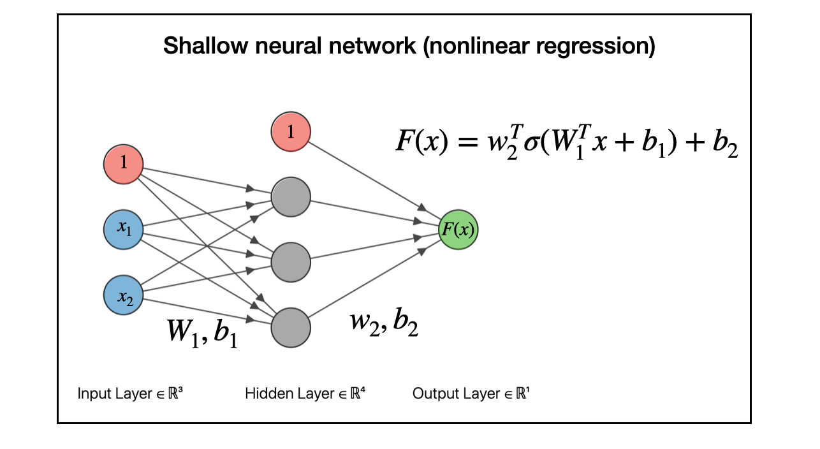
Neural Networks
Once we add an intermediate layer with hidden neurons, the neural network becomes non-linear.
Each layer of nodes receives inputs from the previous layers.
The outputs of the nodes in one layer are inputs to the next layer.
The inputs to each node are
combined using a weighted linear combination.
The result is then modified by a nonlinear function before
being output.
Retrieve from: https://joshuagoings.com/2020/05/05/neural-network/
Notes:
Modern developments of neural networks are much more complicated. I'm simplifying a lot of the details, but the general idea remains: neural networks are models for performing nonlinear regressions, and they are built from linear models. They take one of the workhorses of scientific analysis, linear regression, and generalize it to handle complex, nonlinear relationships between data.

Slide 13
Neural Networks
Advantages:
Robust with noisy data
Disadvantages:
Less interpretable
Need longer training times
Neural Networks have a tendency to over-fit the relationship between predictor and response due the large coefficients

Slide 14
MARS (Multivariate Adaptive Regression Splines)
MARS blongs to the group of regression algorithms used to predict continuous (numerical ) target variables
Can be used instead of linear regression. Examples are below:
Estimating the price of an asset based on its characteristics
Predicting home energy consumption based on time of day and outside temperature
Estimating inflation based on interest rates, money supply, and other macroeconomic indicators
Notes:
Regression itself is part of the supervised Machine Learning category that uses labeled data to model the relationship between data inputs (independent variables) and outputs (dependent variables).

Slide 15
MARS – The Basic idea
Linear models make a strong assumption about linearity
MARS – improved version of linear regression
Multivariate adaptive regression splines (MARS) provide a convenient approach to capture the nonlinear relationships in the data by assessing cut points (knots). The procedure assesses each data point for each predictor as a knot and creates a linear regression model with the candidate feature(s).
Notes:
The beauty of linear regression is its simplicity, as it assumes a linear relationship between inputs and outputs (except for polynomial regression, a special case of multiple linear regression, used to model non-linear relationships).
However, the interaction between metrics in the real-world is often non-linear, which means that simple linear regression cannot always give us a good approximation of outputs given the inputs. This is where MARS comes to the rescue.
Linear models make a strong assumption about linearity, and this assumption is often a poor one, which can affect predictive accuracy.
Multivariate adaptive regression splines algorithm is best summarized as an improved version of linear regression that can model non-linear relationships between the variables. functions joined together by one or more hinge function

Slide 16
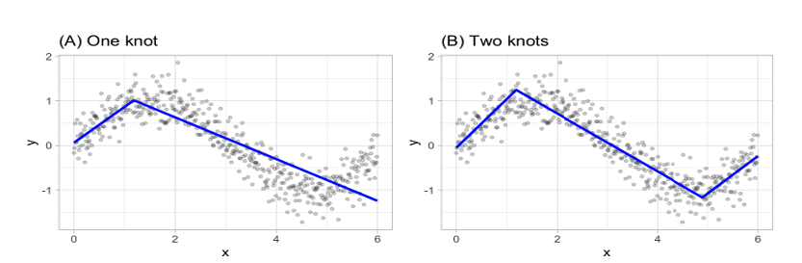
MARS
For example, consider a non-linear, non-monotonic data where Y=f(X).
The MARS procedure will first look for the single point across the range of X values where two different linear relationships between Y and X achieve the smallest error (e.g., smallest SSE).
The results is known as a hinge function h(x−a), where a is the cut point value.
Once the first knot has been found, the search continues for a second knot

Slide 17
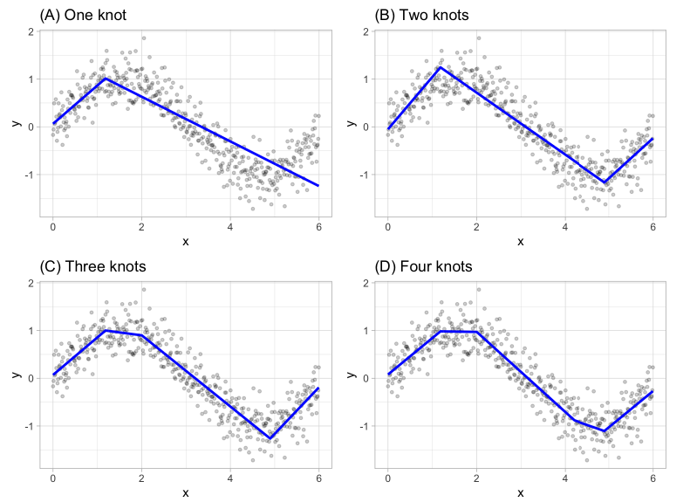
MARS
Notes:
This procedure continues until many knots are found, producing a (potentially) highly non-linear prediction equation. Although including many knots may allow us to fit a really good relationship with our training data, it may not generalize very well to new, unseen data. Consequently, once the full set of knots has been identified, we can sequentially remove knots that do not contribute significantly to predictive accuracy.

Slide 18
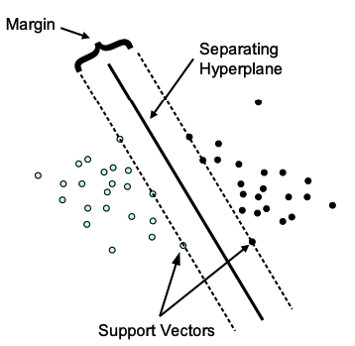
SVM (Support Vector Machines)
SVMs were developed by Cortes & Vapnik (1995) for binary classification.
Their approach may be roughly sketched as follows:
Class separation: We are looking for the optimal separating hyperplane between the two classes by maximizing the margin between the classes’ closest points –
The points lying on the boundaries are called support vectors, and the middle of the margin is our optimal separating hyperplane;

Slide 19
SVM (Support Vector Machines)
Approach (contn’d):
Overlapping classes: data points on the “wrong” side of the discriminant margin are weighted down to reduce their influence (“soft margin”);
Nonlinearity: when we cannot find a linear separator, data points are projected into an (usually) higher-dimensional space where the data points effectively become linearly separable

Slide 20
SVM (Support Vector Machines)
Classification:
One-class-classification
Multi-class classification
Regression

Slide 21
SVM Advantage
Works well on smaller cleaner datasets
It can be more efficient because it uses a subset of training points
Different kernel functions can be specified for the decision function
Ability to handle large feature spaces
Complexity does not depend on the dimensionality of the feature space
Overfitting can be controlled by soft margin approach
Guaranteed to converge to a single global solution (convex optimization)
Notes:
SVMs have a number of advantages compared to other ML algorithms

Slide 22
SVM Disadvantage
Sensitive to noise
A relatively small number of mislabeled examples can dramatically decrease the performance
Essentially a binary classifier
Isn’t suited to larger datasets as the training time with SVMs can be high
Less effective on noisier datasets with overlapping classes
If the number of features is a lot bigger than the number of data points, avoiding over-fitting when choosing kernel functions and regularization term is crucial.

Slide 23
SVM -Applications
Face Detection - SVM classify parts of the image as a face and non-face and create a square boundary around the face.
Text and Hypertext categorization
Image classification
Bioinformatics – It includes protein classification and cancer classification. We use SVM for identifying the classification of genes, patients on the basis of genes and other biological problems.

Slide 24
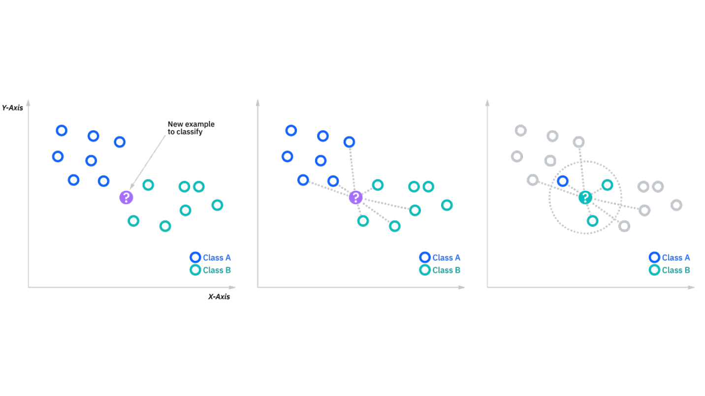
KNN (K-Nearest Neighbors)
The k-nearest neighbors algorithm, is a non-parametric, supervised learning classifier, which uses proximity to make classifications or predictions about the grouping of an individual data point.
While it can be used for either regression or classification problems, it is typically used as a classification algorithm, working off the assumption that similar points can be found near one another.
The k value in the k-NN algorithm defines how many neighbors will be checked to determine the classification of a specific query point.

Slide 25
KNN advantages
Easy to implement: Given the algorithm’s simplicity and accuracy, it is one of the first classifiers that a new data scientist will learn.
- Adapts easily: As new training samples are added, the algorithm adjusts to account for any new data since all training data is stored into memory.
- Few hyperparameters: KNN only requires a k value and a distance metric, which is low when compared to other machine learning algorithms.
Notes:
APPLICATION
Credit scoring analysis using weighted k nearest neighbor

Slide 26
KNN disadvantages
Does not scale well: Since KNN is a lazy algorithm, it takes up more memory and data storage compared to other classifiers
Curse of dimensionality: The KNN algorithm tends to fall victim to the curse of dimensionality, which means that it doesn’t perform well with high-dimensional data inputs
Prone to overfitting: Due to the “curse of dimensionality”, KNN is also more prone to overfitting. While feature selection and dimensionality reduction techniques are leveraged to prevent this from occurring, the value of k can also impact the model’s behavior
Notes:
Scale: . This can be costly from both a time and money perspective. More memory and storage will drive up business expenses and more data can take longer to compute. While different data structures, such as Ball-Tree, have been created to address the computational inefficiencies, a different classifier may be ideal depending on the business problem.
Curse of dimensionality: additional features increases the amount of classification errors, especially when the sample size is smaller.
Prone to overfitting: . Lower values of k can overfit the data, whereas higher values of k tend to “smooth out” the prediction values since it is averaging the values over a greater area, or neighborhood. However, if the value of k is too high, then it can underfit the data.

Slide 27
KNN Applications
Data preprocessing: Datasets frequently have missing values, but the KNN algorithm can estimate for those values in a process known as missing data imputation.
Recommendation Engines: a user is assigned to a particular group, and based on that group’s user behavior, they are given a recommendation. However, given the scaling issues with KNN, this approach may not be optimal for larger datasets.
Finance: It has also been used in a variety of finance and economic use cases. For example, using KNN on credit data can help banks assess risk of a loan to an organization or individual
Healthcare: KNN has also had application within the healthcare industry, making predictions on the risk of heart attacks and prostate cancer.
Pattern Recognition: KNN has also assisted in identifying patterns, such as in text and digit classification
Notes:
APPLICATION
Credit scoring analysis using weighted k nearest neighbor

Slide 28
Resources:
Kuhn M. Johson K. Applied Predective Modeling. Springer. 2013
https://bradleyboehmke.github.io/HOML/svm.html
https://cran.r-project.org/web/packages/e1071/vignettes/svmdoc.pdf

